Slide 1
VOCABULARY
Life in Roman villa

Slide 2
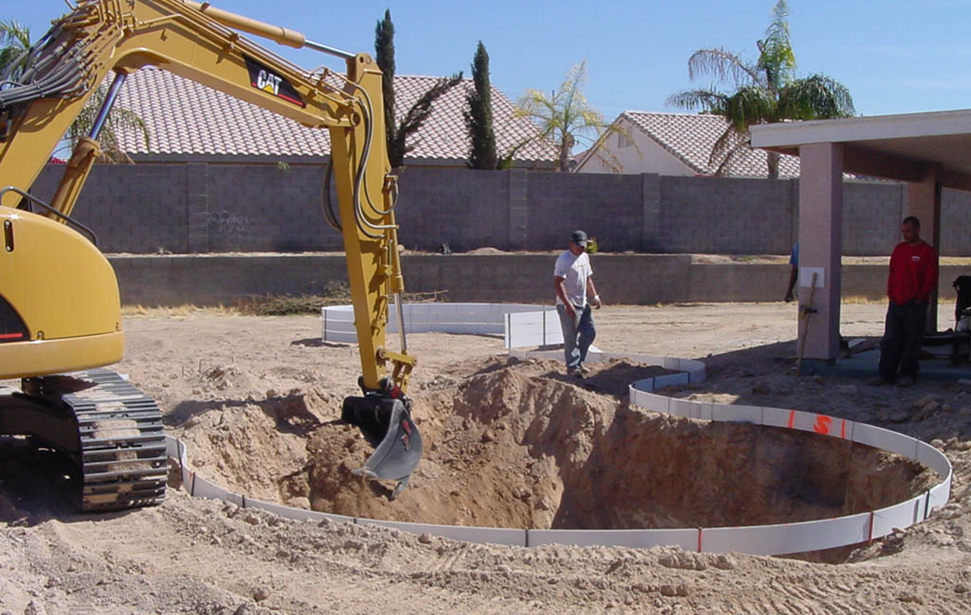
Excavation

Slide 3
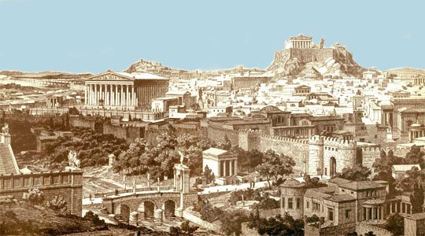
Ancient cities

Slide 4
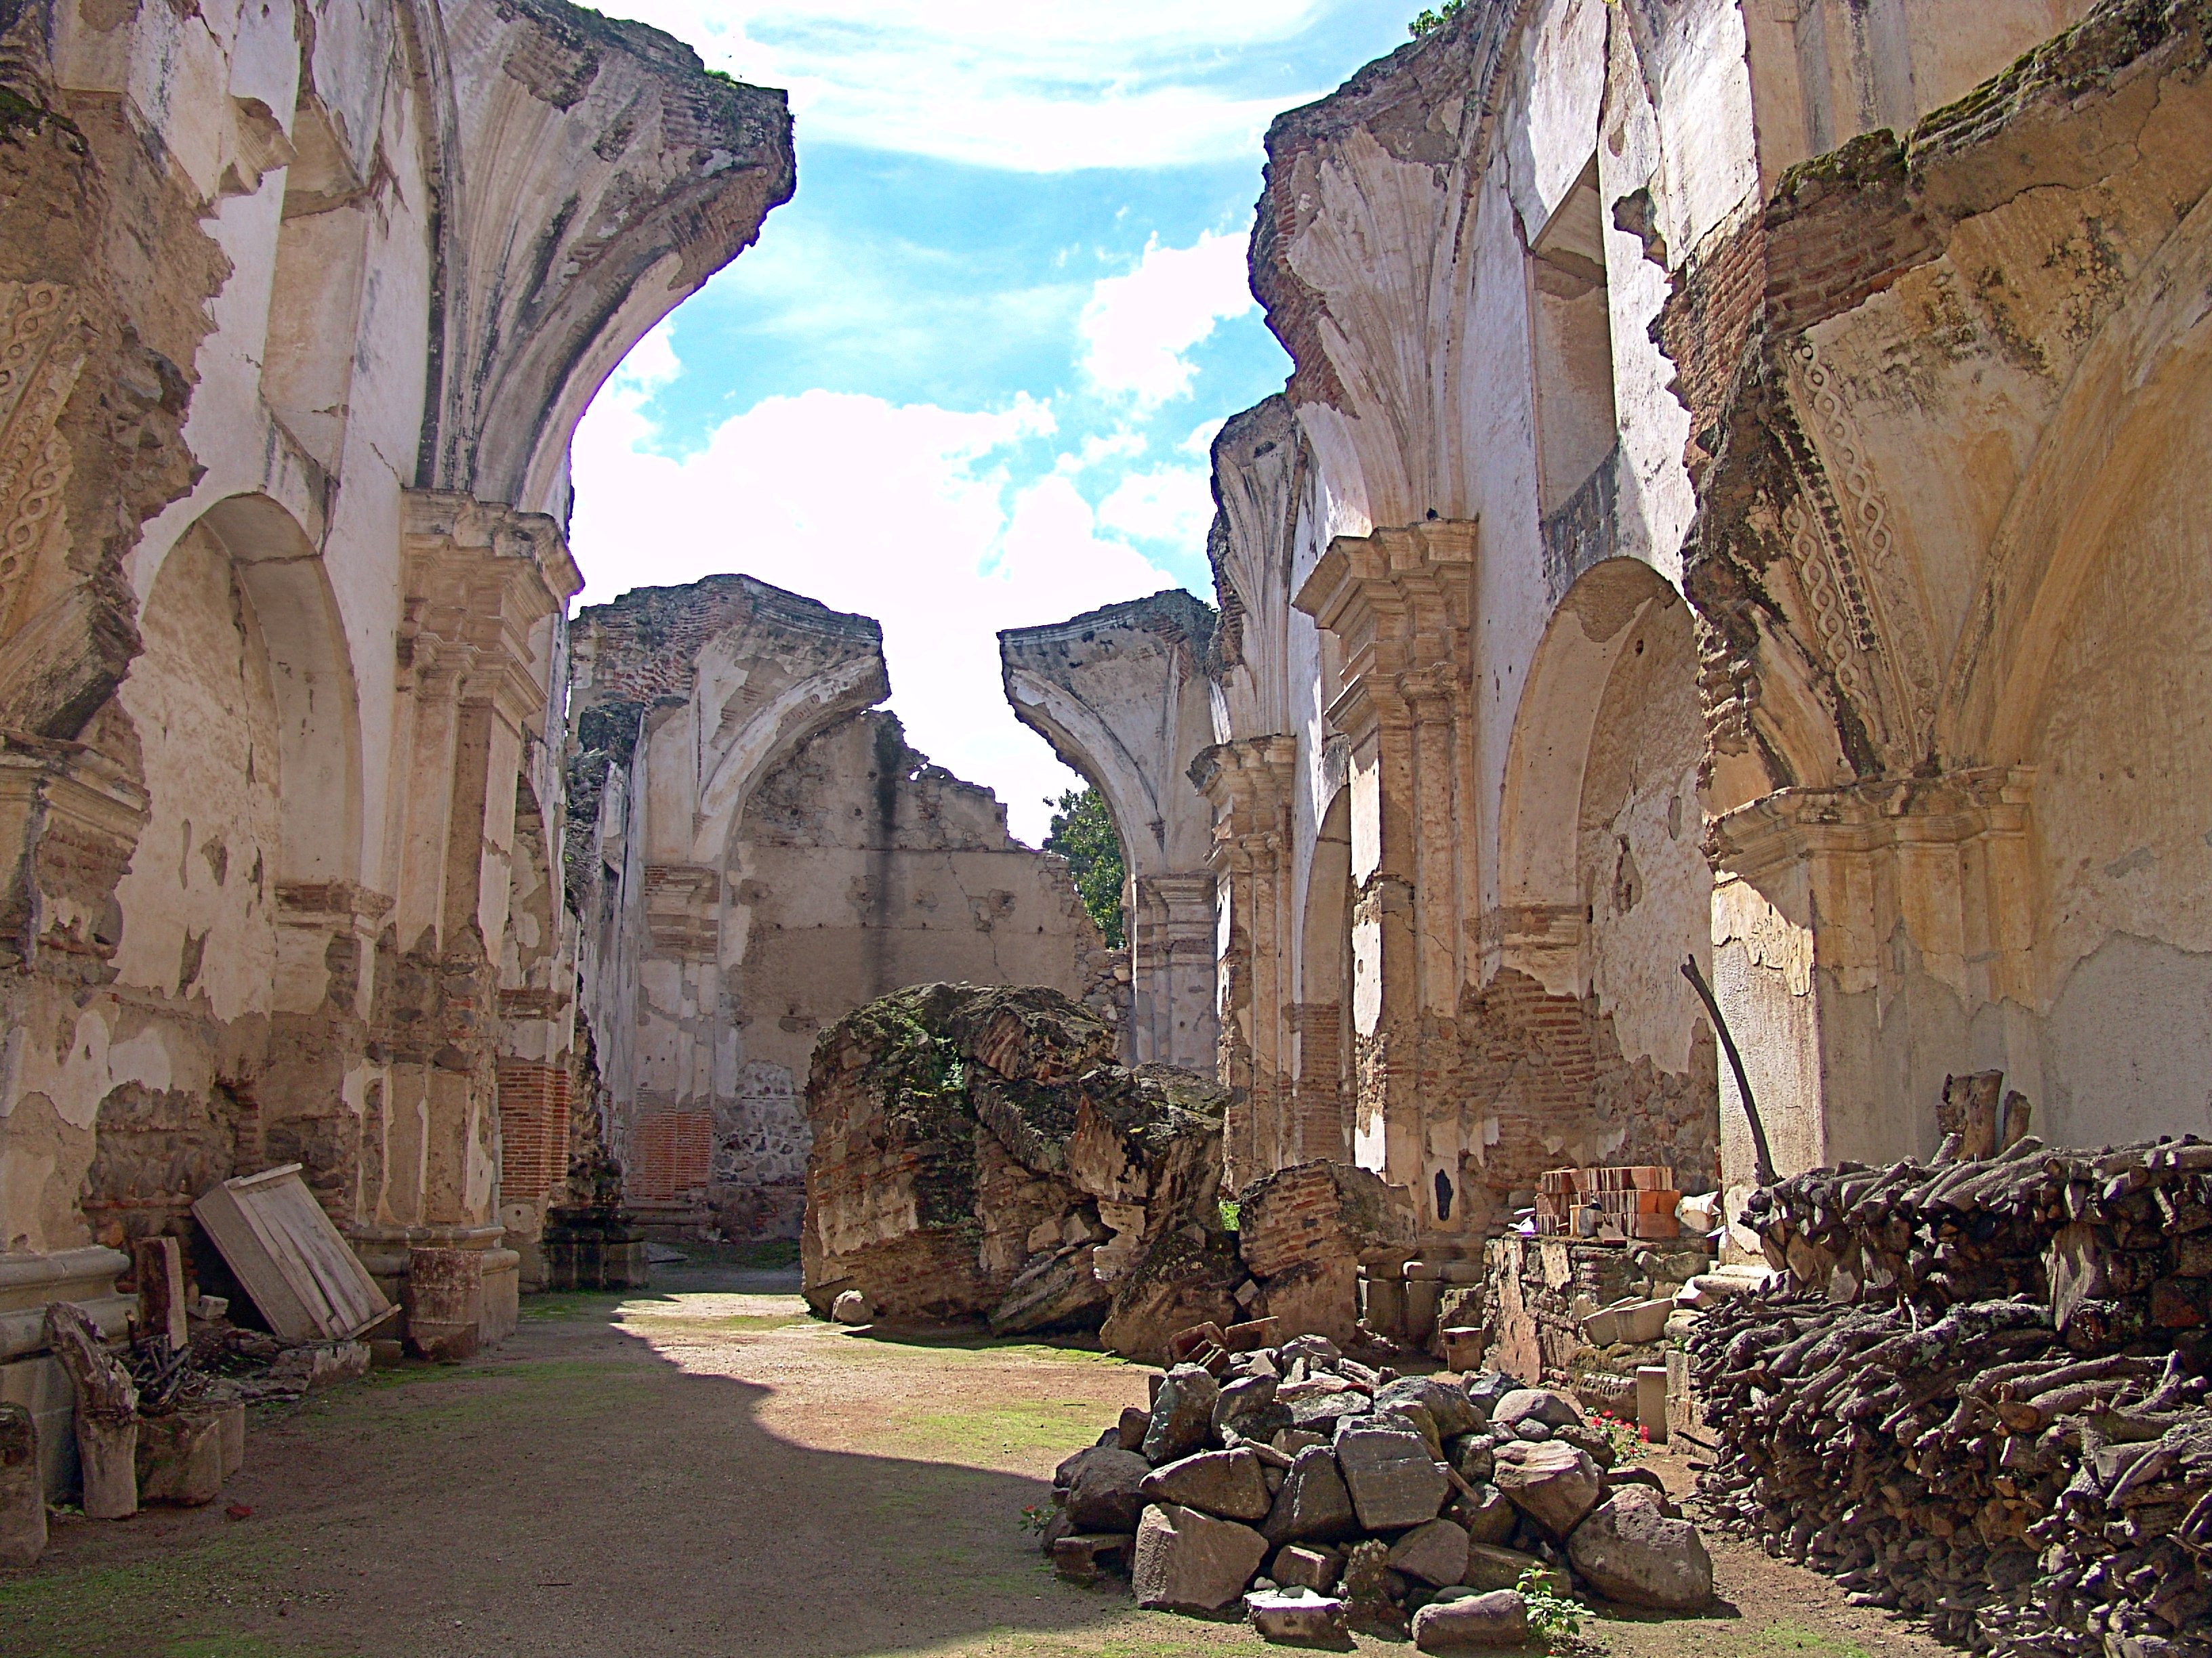
Ruins

Slide 5
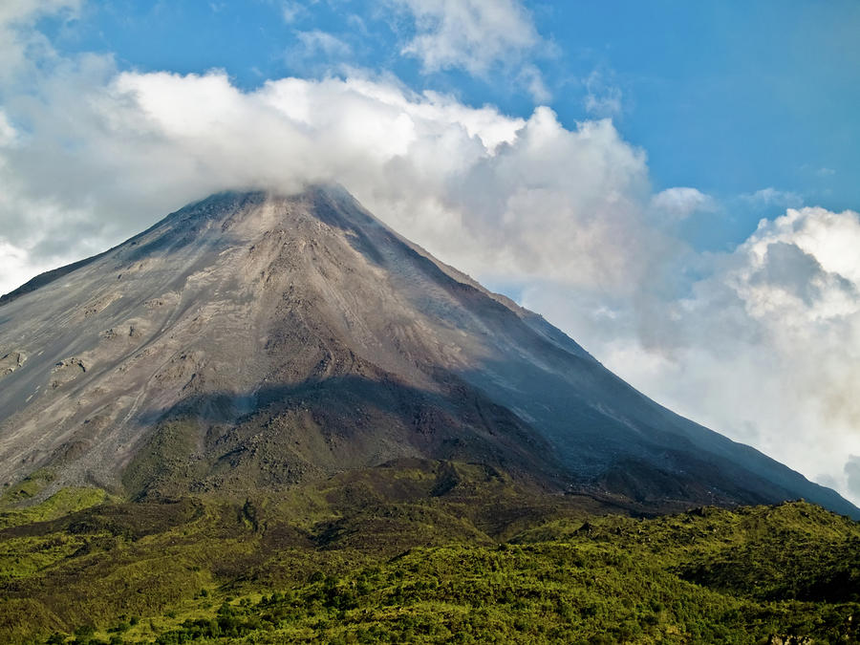
Volcano

Slide 6
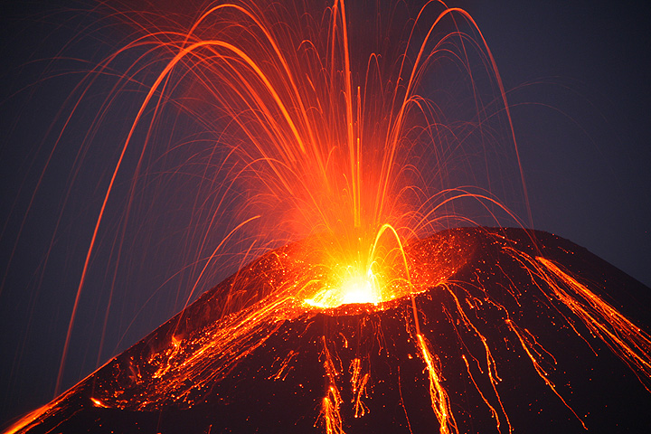
Eruption

Slide 7
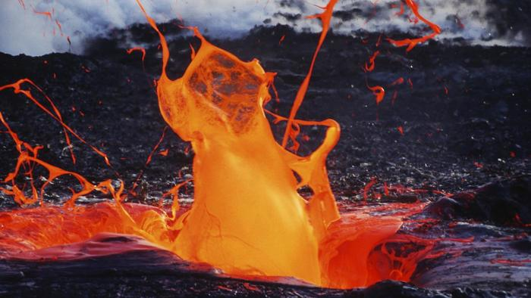
Magma

Slide 8
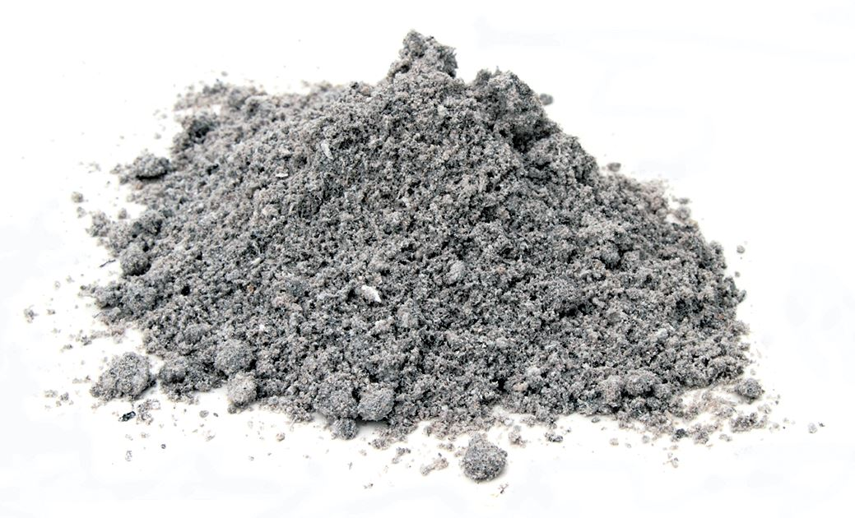
Ash

Slide 9
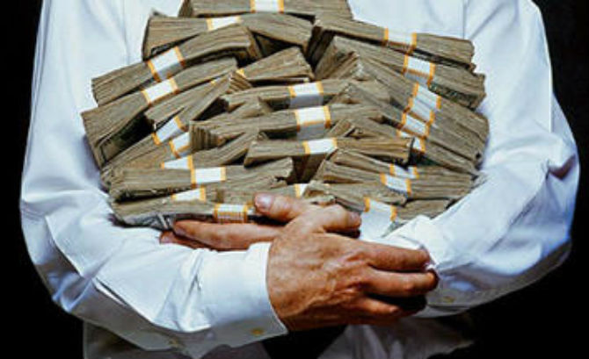
Wealthy people- rich people

Slide 10
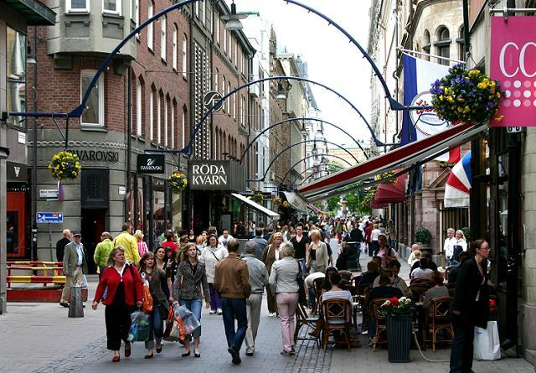
City-citizens (people who live in the city)

Slide 11
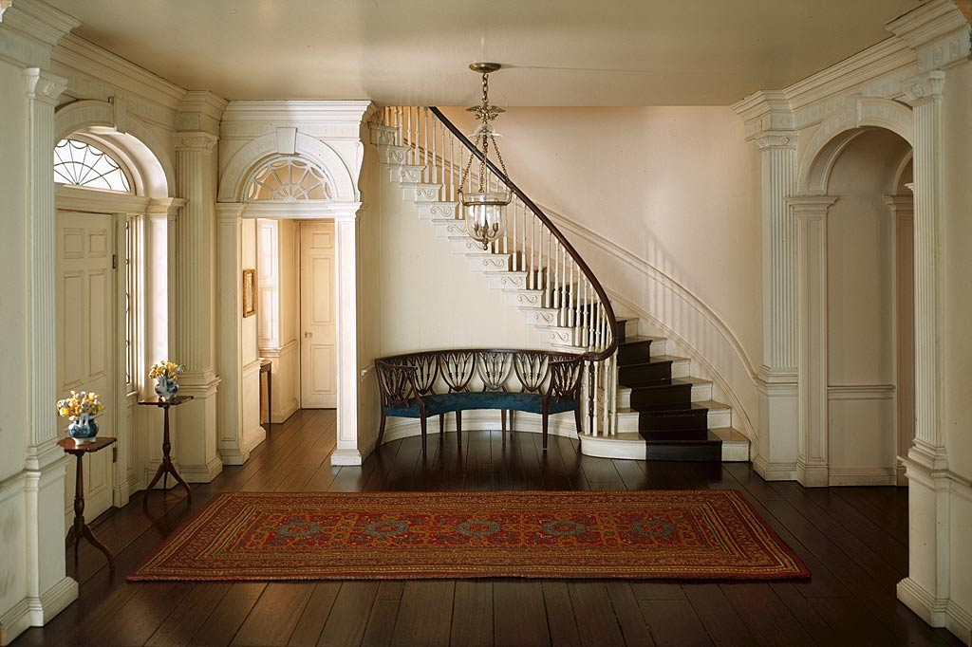
Entrance hall

Slide 12
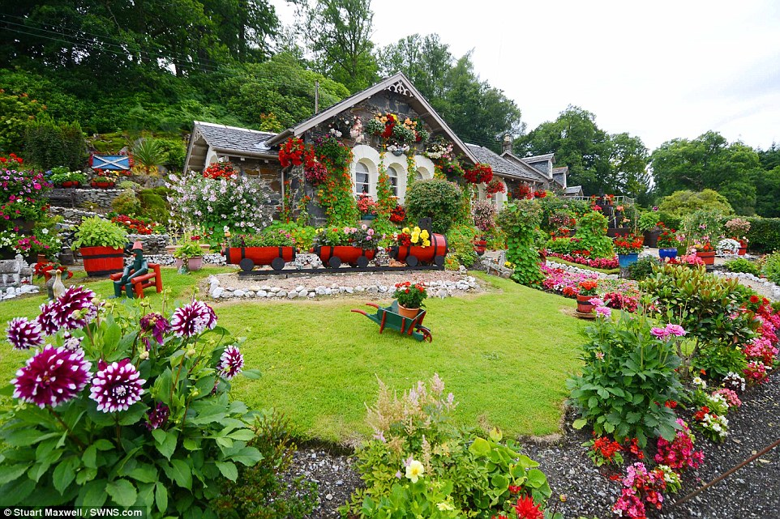
Garden

Slide 13
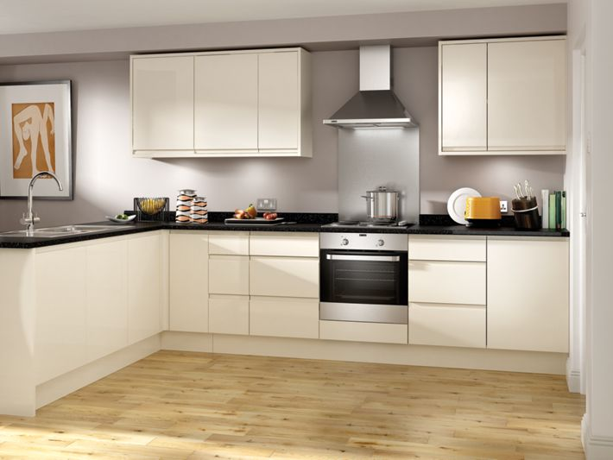
Kitchen

Slide 14
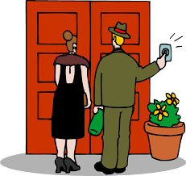
Visitors

Slide 15

Frequent

Slide 16
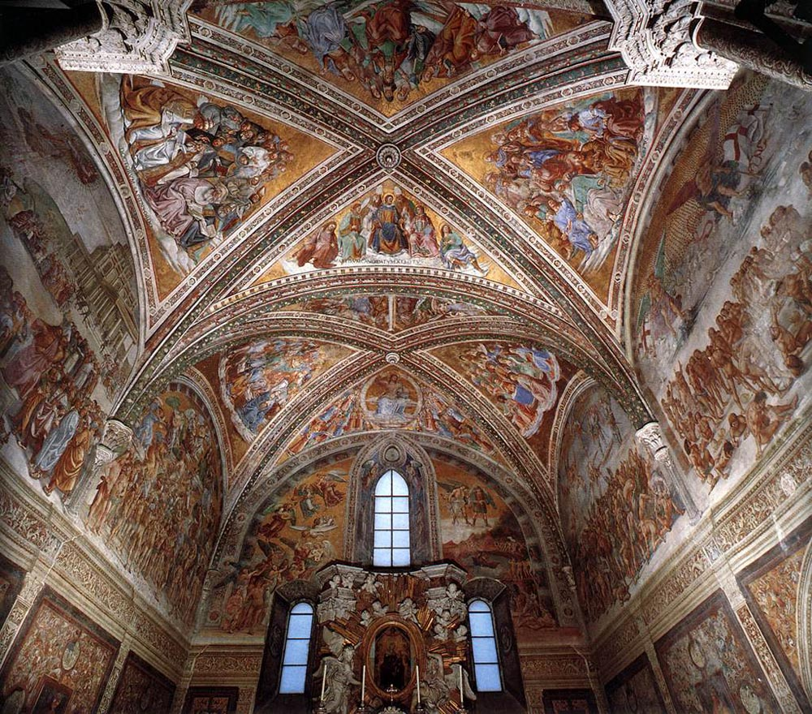
Frescoes

Slide 17
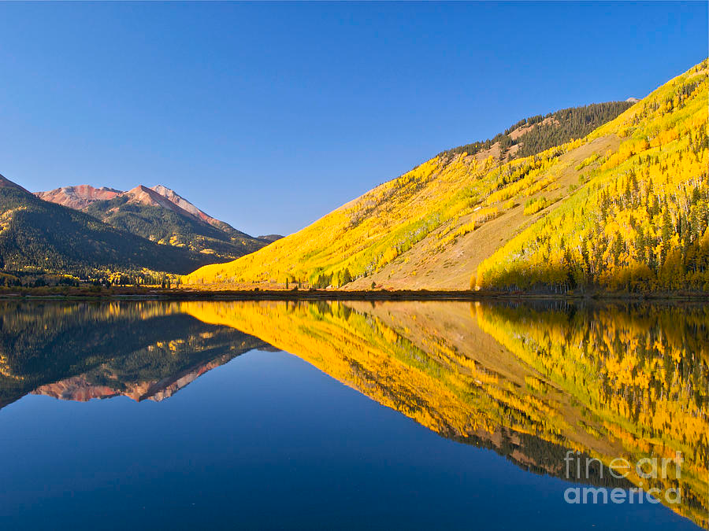
Reflects

Slide 18
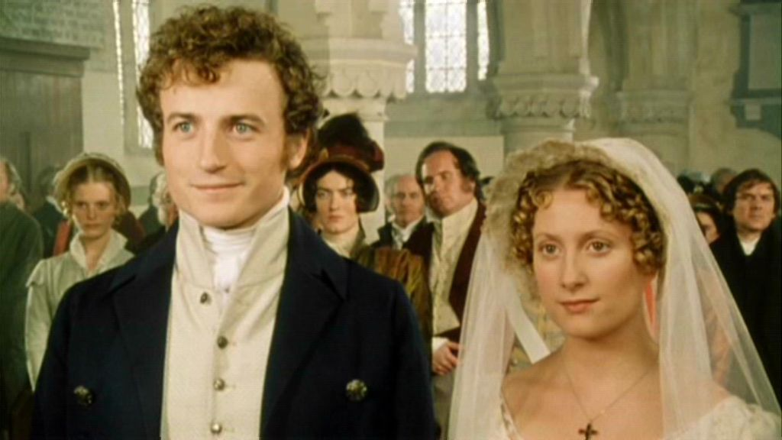
Couple

Slide 19

Pride- proud of

Slide 20
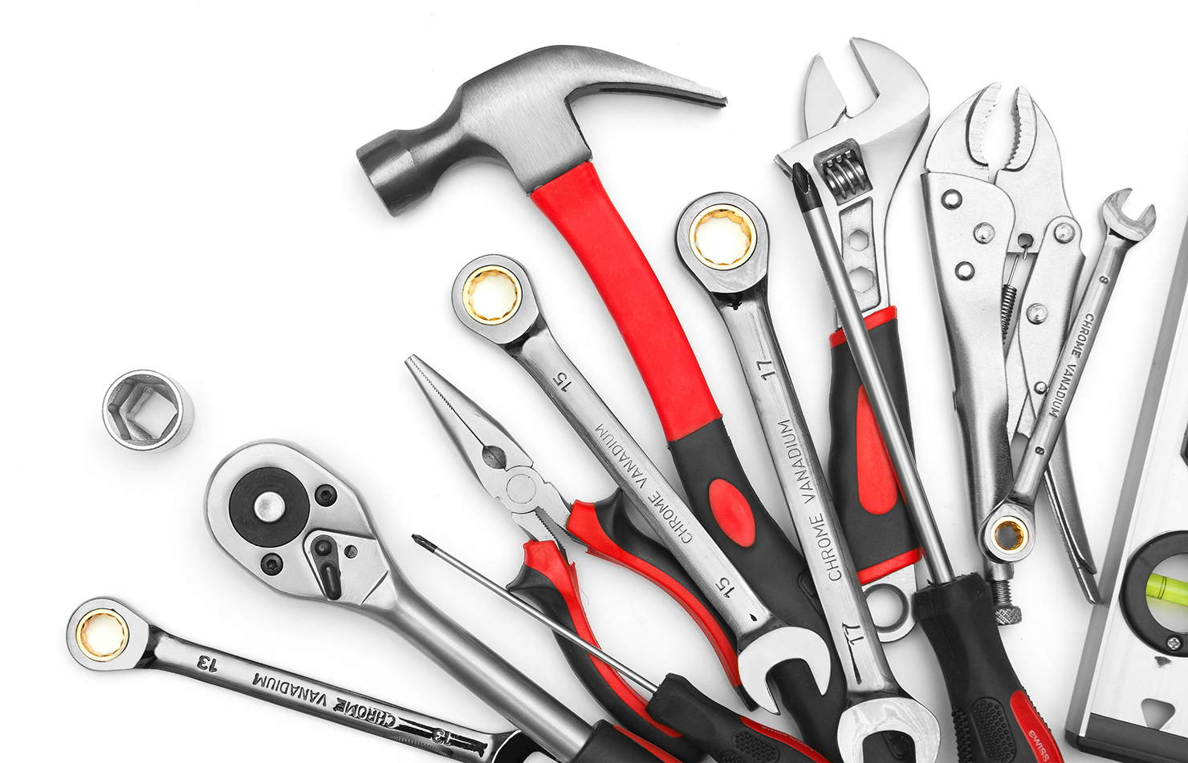
Tools

Slide 21

Scroll

